Slide 1
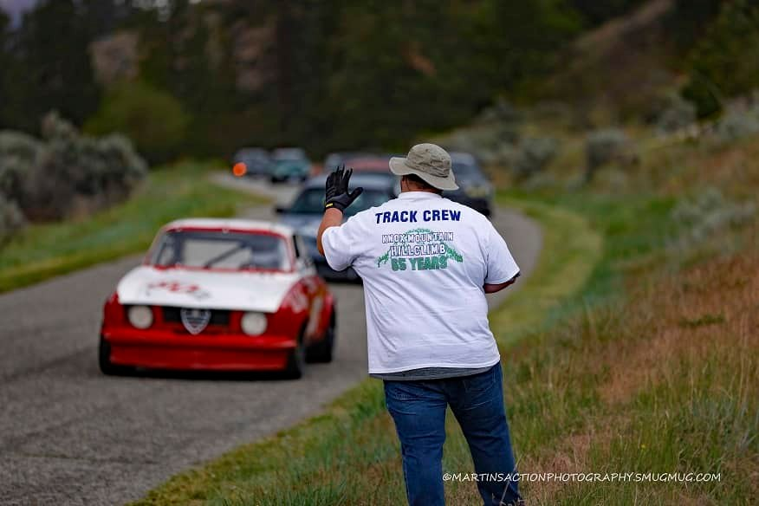
66TH LEAVITT MACHINERY
KNOX MOUNTAIN HILL CLIMB
MAY 17 & 18, 2025
VOLUNTEER OPPORTUNITY

